Slide 1
JavaFX
Università di Modena e Reggio Emilia
Prof. Nicola Bicocchi (nicola.bicocchi@unimore.it)

Slide 2
JavaFX’s modules
Base: include API for bindings, properties, observable collections and events
Controls: include UI controls, charts and skins
Graphics: include API for animation, CSS, concurrency, geometry, printing and windowing
Media: include API for media and audio content
Web: include API for display Web content
FXML: include API for FXML
Swing: include API to include Swing in FX and FX in Swing

Slide 3
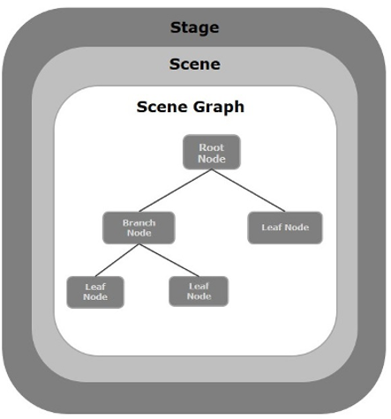
JavaFX application
Theatre metaphor:
Stage: the window
Scene: contains the Scene Graph
A JFX application can have multiple Stage
A Stage can have only one Scene at the same time
Extends Application class and implement the start method
Use the static launch method of the Application class in main, to run the application

Slide 4
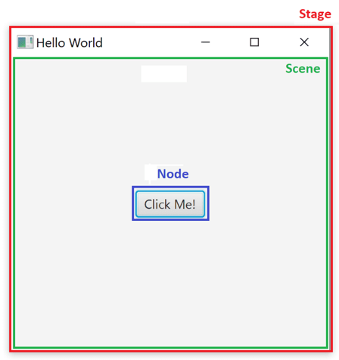
Stage, Scene and node

Slide 5
Node
A node can be:
UI controls (Button, TextArea, CheckBox…)
Containers (Pane, Group, BorderPane, FlowPane…)
Media components (image, audio…)
Geometrical components (polygon, circle, rectangle…)
…
Class that extends Node:

Slide 6
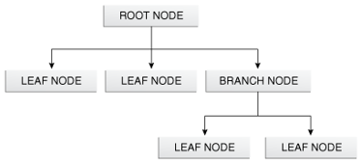
Scene Graph
Hierarchical structure of nodes
A node is a graphical object, like:
Button, Checkbox, BorderPane…
There are 3 types of node:
Root node: first node
Branch node: node with child nodes
Leaf node: node without child nodes

Slide 7
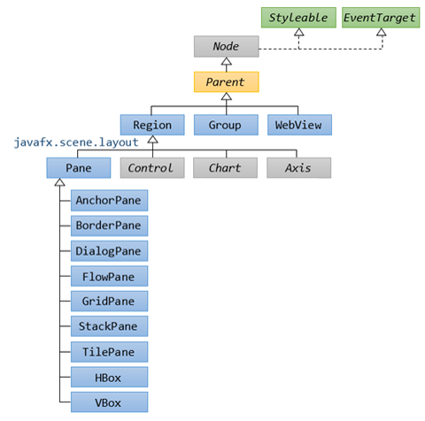
Class hierarchy (Containers)
Layout Pane

Slide 8
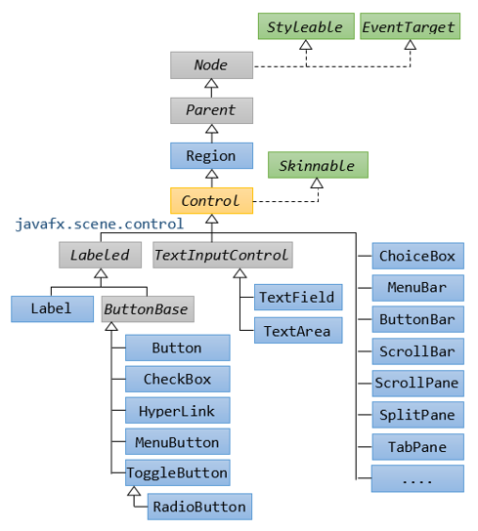
Class hierarchy (Controls)

Slide 9
Styleable
Node class implements Styleable interface
Styleable comprises the minimal interface required for an object to be styled by CSS
Use: .setStyle(“…”)
Or use an extern file.css
.getStylesheets().add(getClass().getResource(“pathFile.css").toExternalForm());
The default CSS theme is “Modena”
Example:
Button button = new Button("My Button");
button.setStyle("-fx-background-color: #ff0000;");

Slide 10
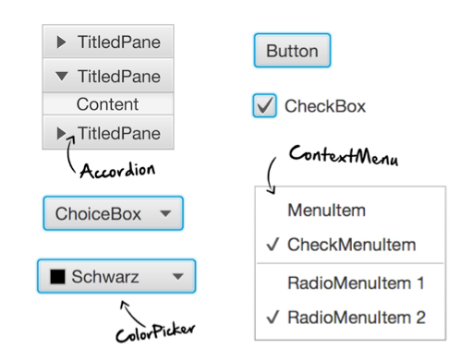
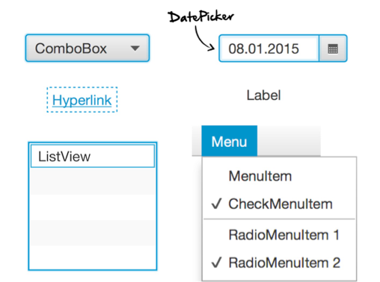
UI Controls

Slide 11
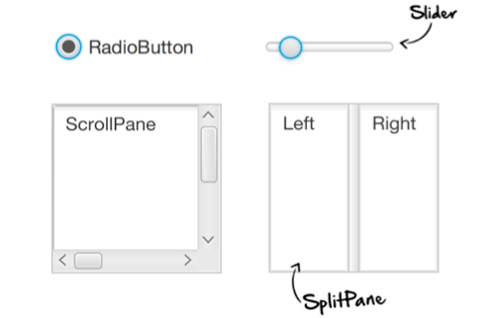
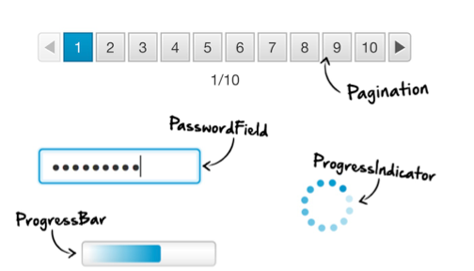
UI Controls

Slide 12
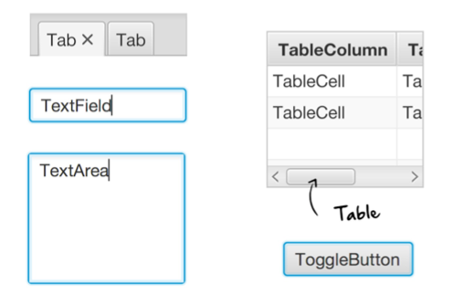
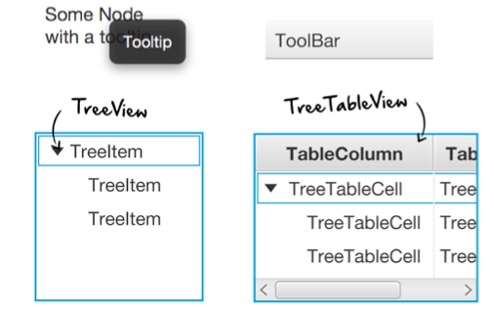
UI Controls

Slide 13
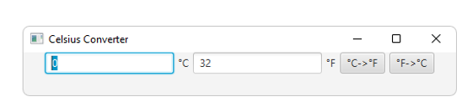
A complete example
public class CelsiusConverterBareMinimum extends Application{
private Button CFButton, FCButton;
private TextField fahrenheitTF, celsiusTF;
@Override
public void start(Stage primaryStage) {
celsiusTF = new TextField("0");
fahrenheitTF = new TextField("32");
CFButton = new Button("°C->°F");
FCButton = new Button("°F->°C");
FlowPane flowPane = new FlowPane(celsiusTF, new Label("°C"), fahrenheitTF, new Label("°F"), CFButton, FCButton);
flowPane.setAlignment(Pos.TOP_CENTER);
flowPane.setHgap(5);
Scene scene = new Scene(flowPane, 500 ,50);
primaryStage.setScene(scene);
primaryStage.setTitle("Celsius Converter");
primaryStage.show();
}
public static void main(String[] args) {
launch(args);
}
}

Slide 14
Properties
Property data types are like wrapper classes, that wrap some data value within them
There are two types of JavaFX Properties:
Read/Writable
Read-Only
Support for JavaBeans
Properties hold actual values and provide change support, invalidation support, and binding capabilities
JavaFX properties are typically used to contain UI components properties such as X position, Y position, width, height, children and other properties in UI components

Slide 15
Properties – Read Only
Classes:
ReadOnlyIntegerProperty : this class provides a full implementation of a read-only Property wrapping an int value
ReadOnlyStringProperty : this class provides a full implementation of a read-only Property wrapping a String value
…
Main methods:
get()
Return the primitive wrapped value

Slide 16
Properties – Read/Writable
Classes:
SimpleIntegerProperty : this class provides a full implementation of a read/writable Property wrapping an int value
SimpleStringProperty : this class provides a full implementation of a read/writable Property wrapping a String value
…
Main methods:
set(X newValue) : set the wrapped value of X type
get() : get the wrapped value

Slide 17
Properties are observable
All JavaFX properties are Observable
This means that when a property’s value becomes invalid or changes, the property notifies its registered listeners
InvalidationListener: is notified when the current value becomes invalid
ChangeListener: it is notified whenever the value changes
Rectangle rect = new Rectangle();
rect.widthProperty().addListener(new ChangeListener<Number>() {
@Override
public void changed(ObservableValue<? extends Number> observable, Number oldValue, Number newValue) {
//code to execute when property change occurs
}
});

Slide 18
Binding
Binding expresses direct relations between variables (observable)
variables called dependencies
the changes brought to one of them will automatically reflect upon the other
Binding can be:
Unidirectional
Bidirectional
Typically used to keep update the data displayed in the UI, but not only

Slide 19
Binding example
Unidirectional:
IntegerProperty source = new SimpleIntegerProperty(10);
IntegerProperty target = new SimpleIntegerProperty();
target.bind(source);
Bidirectional:
IntegerProperty source = new SimpleIntegerProperty(10);
IntegerProperty target = new SimpleIntegerProperty();
target.bindBidirectional(source);

Slide 20
Stage basic methods
setScene(Stene scene)
set the scene
setTitle(String title)
sets the title of the application
setResizable(boolean resizable)
sets whether the window is resizable by the user
initStyle(StageStyle style)
Specifies the style for this stage
StageStyle.DECORATED (default), StageStyle.UNDECORATED, StageStyle.UNIFIED, StageStyle.TRANSPARENT, StageStyle.UTILITY
show()
show the window

Slide 21
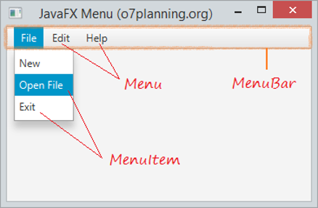
MenuBar Menu MenuItem

Slide 22
MenuBar Menu MenuItem
In composing menus, three components are hierarchically involved: MenuBar, Menu, MenuItem
MenuItem open = new MenuItem("Open");
MenuItem close = new MenuItem("Close");
Menu file = new Menu("File");
file.getItems().add(open);
file.getItems().add(close);
MenuBar menuBar = new MenuBar();
menuBar.getMenus().add(file);

Slide 23
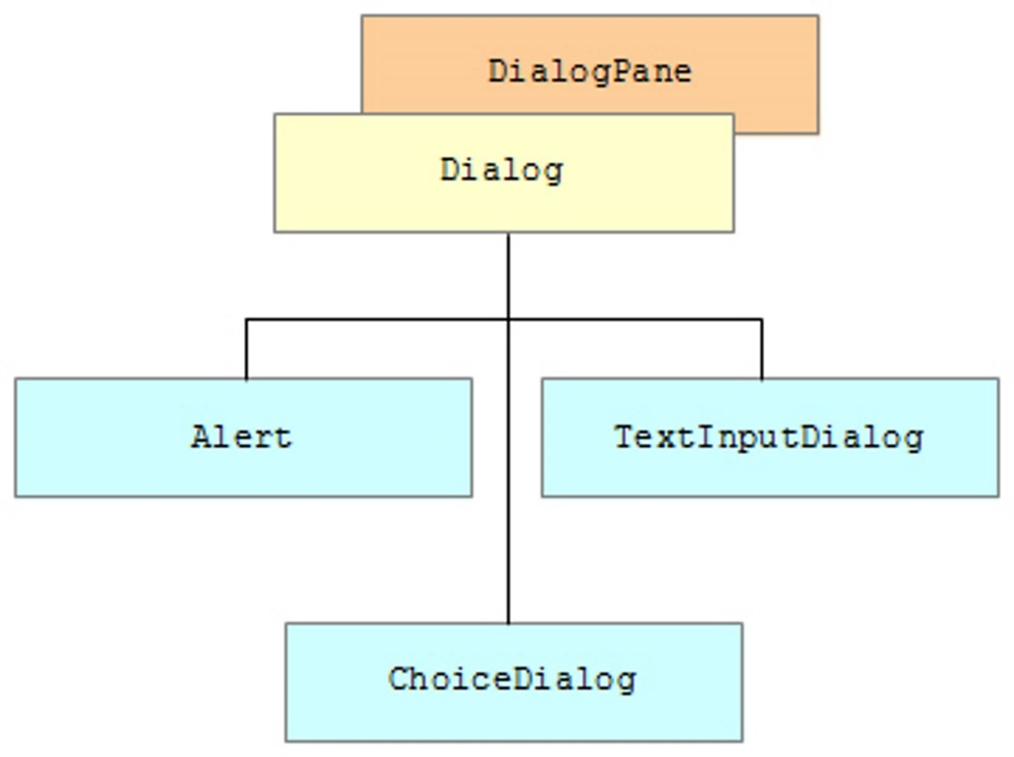
Dialog
A Dialog in JavaFX wraps a DialogPane and provides the necessary API to present it to end users
DialogPane is the root node in a Dialog instance

Slide 24
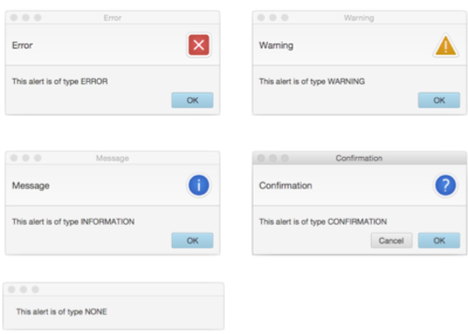
Alert

Slide 25
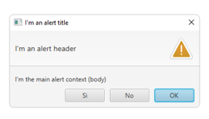
Alert
The Alert class subclasses the Dialog class, and provides support for a number of pre-built dialog types that can be easily shown to users to prompt for a response (similar to Swing’s JOptionPane)
Alert type:
AlertType.NONE
AlertType.CONFIRMATION
AlertType.WARNING
AlertType.INFORMATION
AlertType.ERROR
Main components in an Alert:
Header
Content text
Buttons
Alert.showAndWait():
Shows the dialog and waits for the user response
Return an Optional that contains the result
Alert alert = new Alert(AlertType.WARNING);
alert.setTitle("I'm an alert title");
alert.setHeaderText("I'm an alert header");
alert.setContentText("I'm the main alert context (body)");
alert.getButtonTypes().addAll(ButtonType.YES, ButtonType.NO);
Optional<ButtonType> opt = alert.showAndWait();

Slide 26
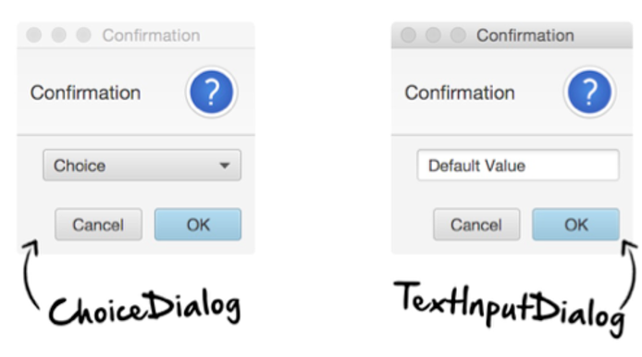
ChoiceDialog and TextInputDialog

Slide 27
ChoiceDialog and TextInputDialog
A ChoiceDialog is a dialog that shows a list of choices from which you can select only one
Contains a choice box
ChoiceDialog<String> dialog = new ChoiceDialog<String>("Monday", "Tuesday", "Wednesday", "Thursday", "Friday");
A TextInputDialog is a dialog that allows the user to enter a text
Contains a text field
TextInputDialog dialog = new TextInputDialog("Enter any text");

Slide 28
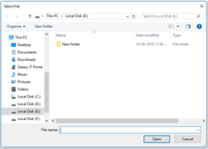
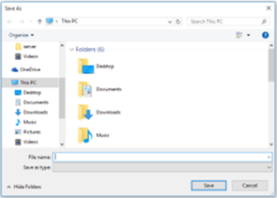
FileChooser
Provides support for standard file chooser dialog
These dialogs have look and feel of the platform UI components which is independent of JavaFX
FileChooser fileChooser = new FileChooser();
fileChooser.setTitle("Select File");
File file = fileChooser.showOpenDialog(mainStage);
FileChooser fileSaver = new FileChooser();
fileChooser.setTitle("Save As");
File file = fileSaver.showSaveDialog(mainStage);

Slide 29
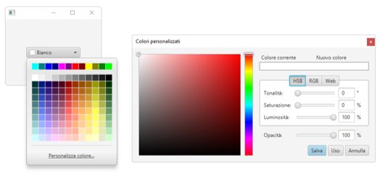
ColorPicker
ColorPicker is a control that enables the user to choose a color in a popup dialog
The chosen color can be read from the ColorPicker
Color color = colorPicker.getValue();
ColorPicker colorPicker = new ColorPicker();

Slide 30
Layout
JavaFX provides several layout panes for the easy setup and management of classic layouts
As a window is resized, the layout pane automatically repositions and resizes the nodes that it contains according to the properties for the nodes
Pane is the base class for layout panes, this class may be used directly in cases where absolute positioning of children is required
Main built-in layout panes that extends Pane are:
AnchorPane
BorderPane
FlowPane
GridPane
StackPane
TilePane
TextFlow
Hbox
Vbox

Slide 31
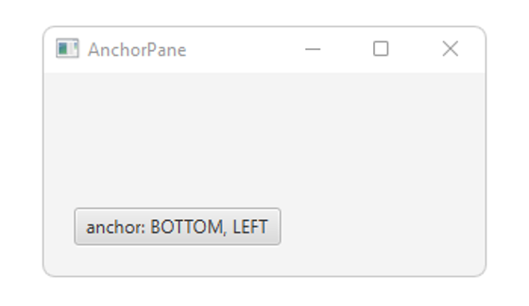
Built-in Layout Panes - AnchorPane
20 left offset
20 bottom offset

Slide 32
Built-in Layout Panes - AnchorPane
The Anchor Pane allows the edges of child nodes to be anchored to an offset from the anchor pane's edges
Nodes can be anchored to more than one position and more than one node can be anchored to the same position
As the window is resized, the nodes maintain their position relative to their anchor point
Constructors:
AnchorPane()
AnchorPane(Node... children)
Methods to set the anchor:
setBottomAnchor(Node child, Double value)
setLeftAnchor(Node child, Double value)
setRightAnchor(Node child, Double value)
setTopAnchor(Node child, Double value)
Value: is the value of the offset from the anchor pane’s edge

Slide 33
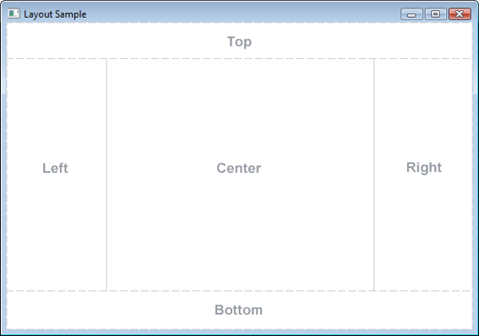
Built-in Layout Panes - BorderPane

Slide 34
Built-in Layout Panes - BorderPane
BorderPane lays out children in top, left, right, bottom, and center positions
Constructors:
BorderPane()
BorderPane(Node center)
BorderPane(Node center, Node top, Node right, Node bottom, Node left)
Properties:
center: represent the node placed in the center in the BorderPane
setCenter(Node center)
top: represent the node placed on the top in the BorderPane
setTop(Node top)
left: represent the node placed on the left in the BorderPane
setLeft(Node left)
right: represent the node placed on the right in the BorderPane
setRight(Node right)
bottom: represent the node placed on the bottom in the BorderPane
setBottom(Node bottom)

Slide 35
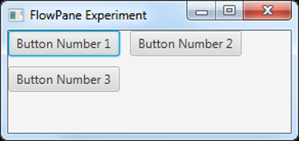
Built-in Layout Panes - FlowPane
hgap
vgap
Horizontal orientation

Slide 36
Built-in Layout Panes - FlowPane
LayoutPane layout wraps all the child nodes in a flow
Nodes can flow vertically (in columns) or horizontally (in rows)
Main constructors:
FlowPane()
FlowPane(Node... children)
FlowPane(Orientation orientation, double hgap, double vgap, Node... children)
Properties:
alignment: represents the flow alignment
setAlignment(Pos value) value: Pos.CENTER, Pos.BOTTOM_CENTER, Pos.TOP, Pos.TOP_LEFT …
columnHalignment: represents the horizontal alignment of nodes within each column of a vertical flow pane
setColumnHalignment(HPos value) value: HPos.CENTER, HPos.LEFT, HPos.RIGHT
rowValignment: represents the vertical alignment of nodes within each column of a vertical flow pane
setRowValignment(VPos value) value: VPos.BASELINE, VPos.BOTTOM, VPos.CENTER, VPos.TOP
orientation: represents the orientation
setOrientation(Orientation orientation) orientation: Orientation.HORIZONTAL, Orientation.VERTICAL
hgap: represents the horizontal space between each node
setHgap(double hgap)
vgap: represents the vertical space between each node
setVgap(double vgap)
prefWrapLength: width were content should wrap in a horizontal flow pane
setPrefWrapLenght(double value)

Slide 37
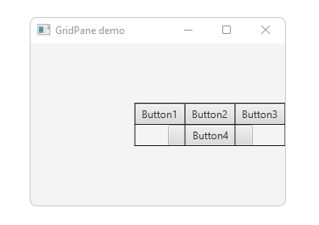
Built-in Layout Panes - GridPane
CENTER_RIGHT alignment
grid line visible
CENTER Button4 horizontal alignment
Button4 span 3 columns

Slide 38
Built-in Layout Panes - GridPane
GridPane lays out its children within a flexible grid of rows and columns
A child may be placed anywhere in the grid and may span multiple rows or columns
Constructor:
GridPane() (hgap/vgap = 0, TOP_LEFT alignment)
Properties:
alignment: represents the alignment of the grid pane
setAlignment(Pos value) value: Pos.CENTER, Pos.BOTTOM_CENTER, Pos.TOP, Pos.TOP_LEFT …
gridLinesVisible: rapresents the visibility of the grid lines
setGridLinesVisible(Boolean value)
hgap: represents the horizontal gap between columns
setHgap(double hgap)
vgap: represents the vertical gap between rows
setVgap(double vgap)
Other methods:
setHalignment(Node child, HPos value)
value: HPos.CENTER, HPos.LEFT, HPos.RIGHT
setValignment(Node child, VPos value)
value: VPos.BASELINE, VPos.BOTTOM, VPos.CENTER, VPos.TOP
add(Node child, int columnIndex, int rowIndex)
add(Node child, int columnIndex, int rowIndex, int colspan, int rowspan)
colspan: column span
rowspan: row span

Slide 39
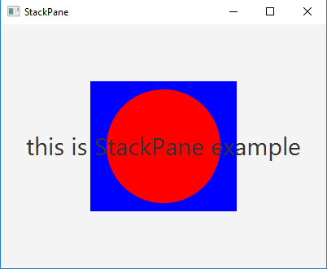
Built-in Layout Panes - StackPane

Slide 40
Built-in Layout Panes - StackPane
In this pane the nodes are placed on top of each other
following the order in which they were added
Constructors:
StackPane() (default CENTER alignment)
StackPane(Node... children) (default CENTER alignment)
Properties:
alignment: alignment of children within the stack pane
setAlignment(Pos value) value: Pos.CENTER, Pos.BOTTOM_CENTER, Pos.TOP, Pos.TOP_LEFT …

Slide 41
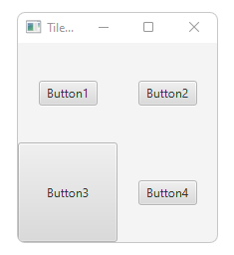
Built-in Layout Panes - TilePane
CENTER tile alignment
The cells (tiles)
are the same size

Slide 42
Built-in Layout Panes - TilePane
TilePane lays out its children in a grid of uniformly sized cell (called “tiles”)
A tile pane can be oriented both vertically and horizontally:
A horizontal tile pane (the default) will tile nodes in rows, wrapping at the tilepane's width
A vertical tilepane will tile nodes in columns, wrapping at the tilepane's height
Main constructors:
TilePane()
TilePane(Node... children)
TilePane(Orientation orientation, double hgap, double vgap, Node... children)

Slide 43
Built-in Layout Panes - TilePane
Main properties:
alignment: represents the alignment
setAlignment(Pos value) value: Pos.CENTER, Pos.BOTTOM_CENTER, Pos.TOP, Pos.TOP_LEFT …
orientation: represents the orientation of the pane
setOrientation(Orientation orientation) orientation: Orientation.HORIZONTAL, Orientation.VERTICAL
hgap: horizontal space between each tile
setHgap(double hgap)
vgap: vertical space between each tile
setVgap(double vgap)
prefColumns: preferred number of columns for a horizontal tile pane
setPrefColumns(int value)
prefRows: preferred number of rows for a vertical tile pane
SetPrefRows(int value)
tileAlignment: alignment of each child within its tile
setTileAlignment(Pos value) value: Pos.CENTER, Pos.BOTTOM_CENTER, Pos.TOP, Pos.TOP_LEFT …
prefTileHeight: preferred height of each tile
setPrefTileHeight(double value)
prefTileWidth: preferred width of each tile
setPrefTileWidth(double value)

Slide 44
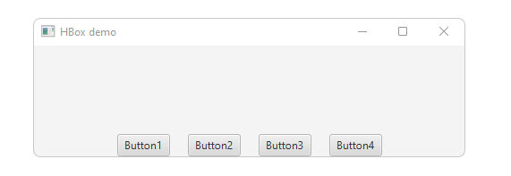
Built-in Layout Panes - HBox
BOTTOM_CENTER alignment
20 spacing

Slide 45
Built-in Layout Panes - HBox
HBox lays out its children in a single horizontal row
Main constructors:
HBox()
Hbox(double spacing, Node... children)
Properties:
alignment: represents the alignment of the nodes in the bounds of the hbox
setAlignment(Pos value) value: Pos.CENTER, Pos.BOTTOM_CENTER, Pos.TOP, Pos.TOP_LEFT …
spacing: is the space between the children in the hbox
setSpacing(double value)
fillHeight: whether or not resizable children will be resized to fill the full height of the hbox
setFillHeight(boolean value)

Slide 46
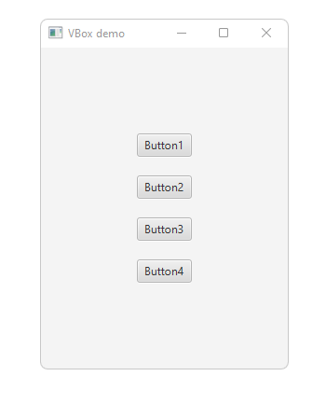
Built-in Layout Panes - VBox
CENTER alignment
20 spacing

Slide 47
Built-in Layout Panes - VBox
VBox lays out its children in a single vertical column
Main constructors:
VBox()
VBox(double spacing, Node... children)
Properties:
alignment: represents the alignment of the nodes in the bounds of the vbox
setAlignment(Pos value) value: Pos.CENTER, Pos.BOTTOM_CENTER, Pos.TOP, Pos.TOP_LEFT …
spacing: is the space between the children in the vbox
setSpacing(double value)
fillWidth: whether or not resizable children will be resized to fill the full width of the vbox
setFillWidth(boolean value)

Slide 48
JavaFX Events
Università di Modena e Reggio Emilia
Prof. Nicola Bicocchi (nicola.bicocchi@unimore.it)

Slide 49
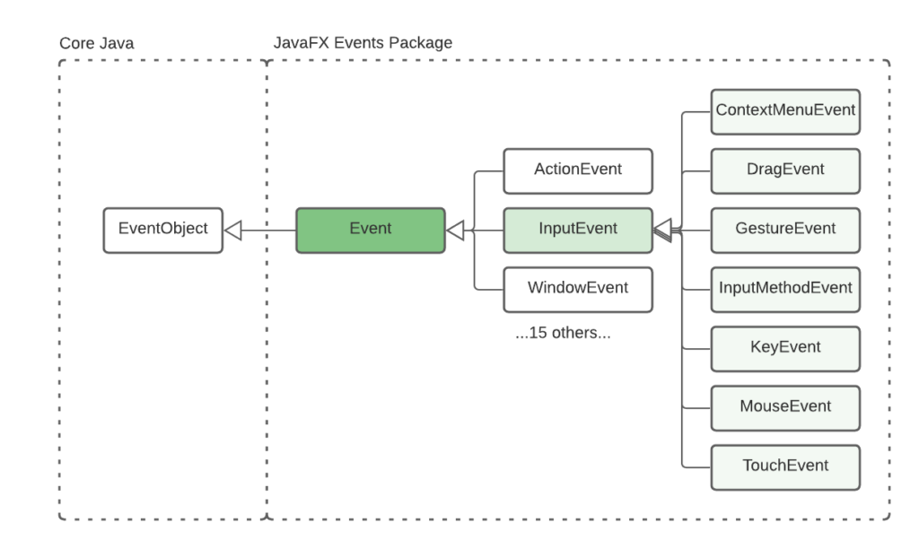
Hierarchy

Slide 50
Event
Events are classified by a subtype of javafx.event.Event class or an instance of Event class
Events are generated by a user (a mouse click), an application (a timer) or in other way
Event properties:
Event type: classification and type of event
Source: origin of the event, the source changes as the event is passed along the event dispatch chain
Target: the node on which the action occurred (the last node in the event dispatch chain)
The piece of code executed after an event occurs is performed by an event handler

Slide 51
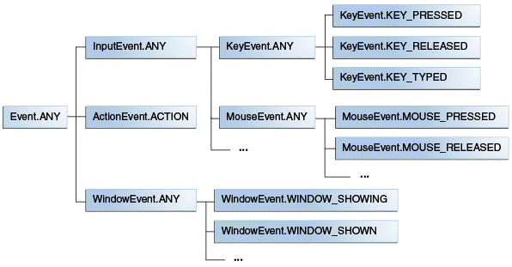
Event type
Event type is rappresented by: EventType<T extends Event>

Slide 52
EventHandler
The event source creates an event object of an event type and sends it to each registered handler
An event handler extends EventHandler interface
EventHandler handle the events of a specific type
EventHandler<T> eventHandler = new EventHandler<T>() {
@Override
public void handle(T e) {
//code
}
};

Slide 53
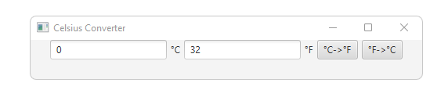
A complete example
public class CelsiusConverter extends Application implements EventHandler<ActionEvent> {
private Button CFButton, FCButton;
private TextField fahrenheitTF, celsiusTF;
@Override
public void start(Stage primaryStage) {
celsiusTF = new TextField("0");
fahrenheitTF = new TextField("32");
CFButton = new Button("°C->°F");
CFButton.setOnAction(this);
FCButton = new Button("°F->°C");
FCButton.setOnAction(this);
FlowPane flowPane = new FlowPane(celsiusTF, new Label("°C"), fahrenheitTF,
new Label("°F"), CFButton, FCButton);
flowPane.setAlignment(Pos.TOP_CENTER);
flowPane.setHgap(5);
Scene scene = new Scene(flowPane, 500 ,50);
primaryStage.setScene(scene);
primaryStage.setTitle("Celsius Converter");
primaryStage.show();
}

Slide 54
A complete example
@Override
public void handle(ActionEvent event) {
if(event.getSource() == CFButton){
int tempFahr = (int)((Double.parseDouble(celsiusTF.getText())) * 1.8 + 32);
fahrenheitTF.setText(Integer.toString(tempFahr));
} else if (event.getSource() == FCButton) {
int tempCelsius = (int)(((Double.parseDouble(fahrenheitTF.getText())) - 32) * 0.555);
celsiusTF.setText(Integer.toString(tempCelsius));
}
}
public static void main(String[] args) {
launch(args);
}
}

Slide 55
How to manage events in JavaFX
Events are managed similarly to exceptions:
sources of events (Button, TextField, etc..) select their receivers
Example: button.setOnAction(receiver)
receivers of events implements EventHandler<T extends Event> interface where T declare which events are able to deal
Pay attention! Receivers must implement handle(T event) method

Slide 56
Dealing with multiple sources
Whenever multiple components register the same handler (e.g., a group of buttons), a mechanism for recognizing the actual source of each event is needed
getSource() and object references
if (event.getSource() == buttonSelfDestruction ){}
Event type
if (event.getEventType() == KeyEvent.KEY_PRESSED){}

